Slide 1
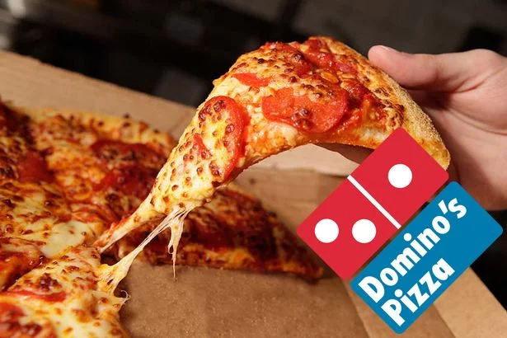
A Data-Driven Marketing Use Case
Sahil Aggarwal, Brian Hudnall, Hye Kim, Neha Palsokar
INFX 547 Winter ’18

Slide 2
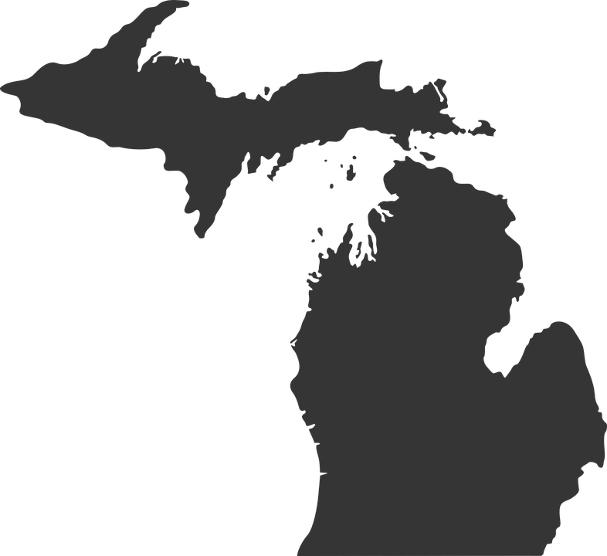



Domino’s Pizza
FOUNDED IN: Michigan in 1960 | FOUNDED BY:
CURRENT CEO: J. Patrick Doyle March 2010- Present | STOCK PRICES 2008 : $3.00 2018 : $211
No Image Found
Tom Monaghan
James Monaghan

Slide 3



Digital Transformation
Heavily invested in technology plan | Utilized analytics team even more | A/B Deployed A/B testing against every new tool/process | Built platforms like Think Oven for quick customer feedback

Slide 4
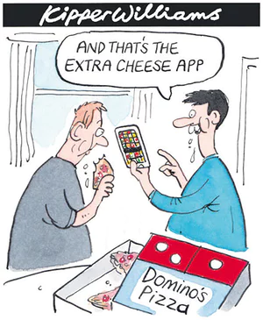
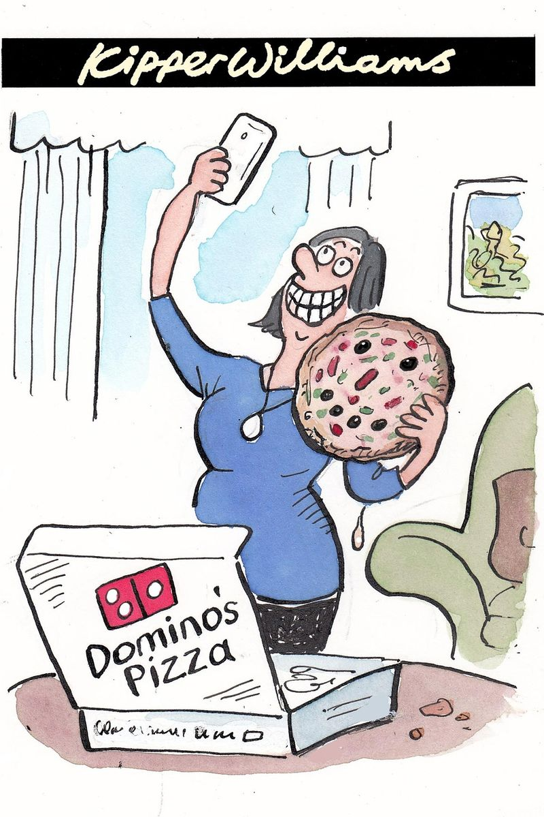
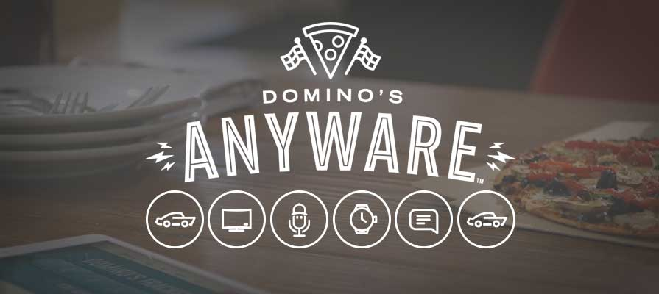








2 PHASES OF DIGITAL TRANSFORMATION
PHASE 1: MOBILE-FIRST APPROACH Digital sales account for majority of sales Mobile sales account for about half | PHASE 2: ORDER FROM ANYWARE This benefits Domino’s customers by giving them ease of flexibility and provides them more digital customer data.

Slide 5
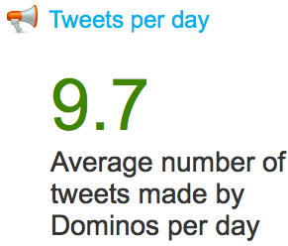
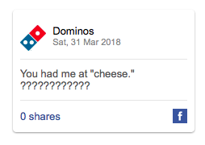
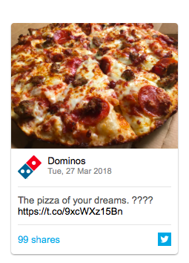
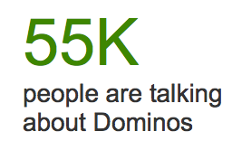
SOCIAL MEDIA DATA
Domino’s turned a crisis into an opportunity with their new technology plan and social media presence (#newpizza).
Information and enrichment data add up to 85,000 data sources (both structured and unstructured). This is then used for personalized ads.
These strategies provide a two way communication between consumers and Domino’s which in turns allows for more strategic changes and quicker turnaround.

Slide 6
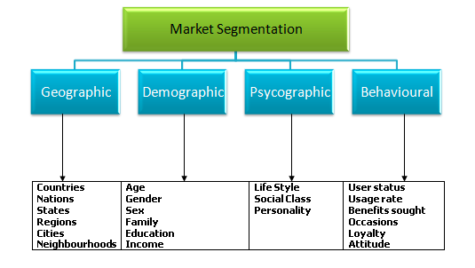
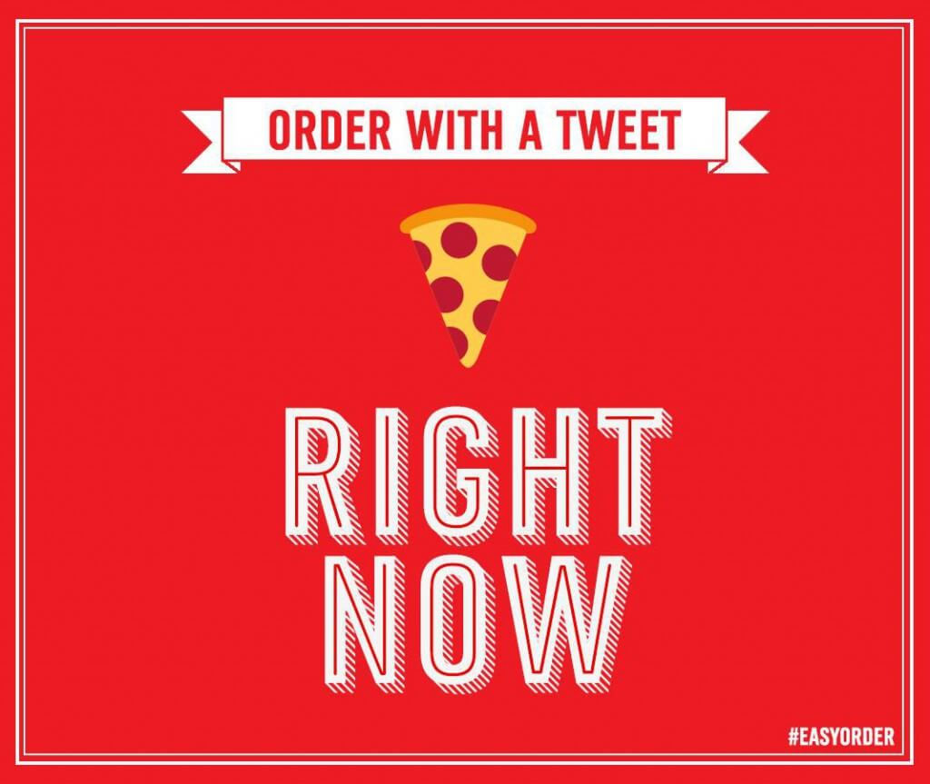
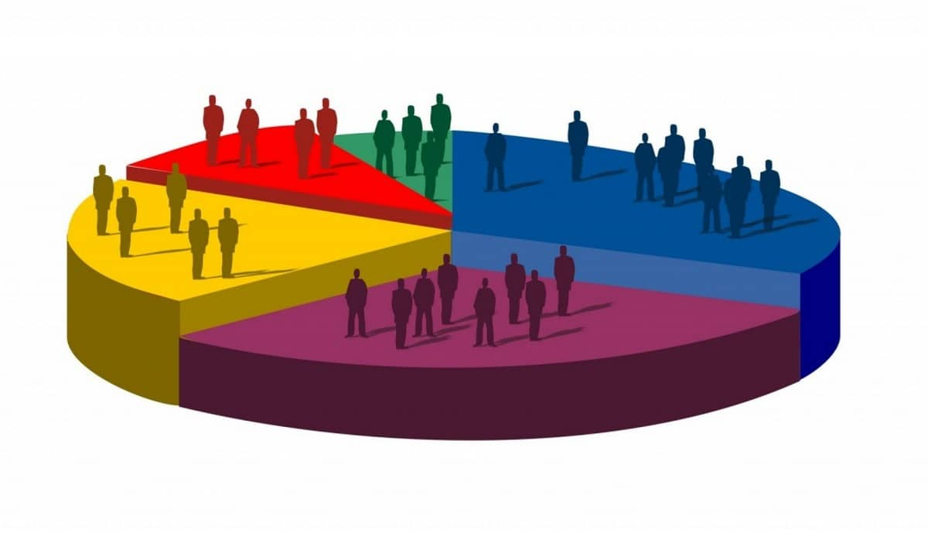
SOCIAL MEDIA DATA CONT’D
Domino’s deploys sophisticated machine learning algorithms to mine those platforms to segment customers into baskets based on four high level parameters:
Geography
Demography
Behavioral
Psychography

Slide 7
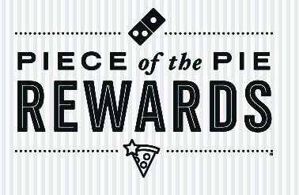











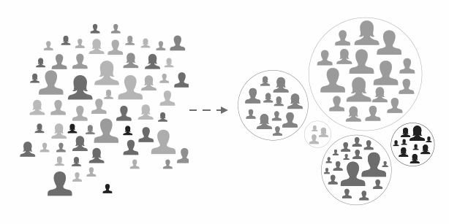




HOW IT WORKS
Digital Ordering Sources/Clickstream Data
Automated Marketing Personalization
Domino’s Loyalty Program
Central Data Location (Domino’s Information Management Framework)
Customer Segmentation
Data Processing/Analysis
POS Ordering Source
Advanced Forecasting Methods
Thirty-Party Data Sources (Enrichment Data)

Slide 8

PERSONALIZATION AND MARKET SEGMENTATION
ASSESS CONSUMERS’ INDIVIDUAL BUYING PATTERNS | TAILOR PRODUCTS AND COUPONS | IMPROVE TARGETED ADS VIA SOCIAL MEDIA
TARGET KEYWORDS TO INCREASE ENGAGEMENT | TARGET NEW CONSUMERS WHO SHOWED INTEREST | BUILD LOYALTY

Slide 9
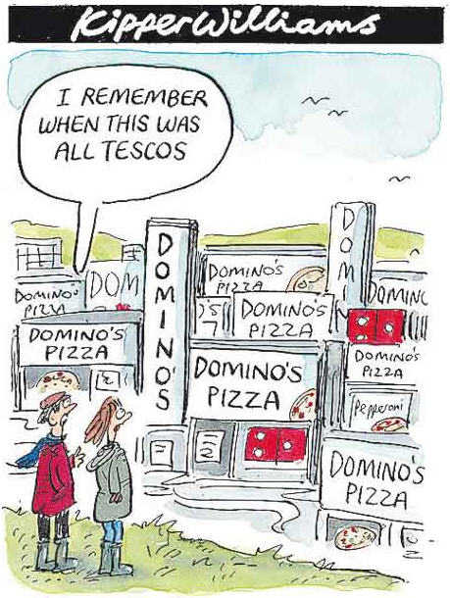
THANK YOU FOR WATCHING

Slide 10
WORKS CITED
Fox, M. 2017. Anyware, Anytime – Domino’s social metrics always one step ahead. Retrieved from https://smbp.uwaterloo.ca/2017/11/anyware-anytime-dominos-social-metrics-always-one-step-ahead/
Litsa, T. 2016. Twitter introduces better targeting with its new Ad Groups tool. Retrieved from https://searchenginewatch.com/2016/04/20/twitter-introduces-better-targeting-with-its-new-ad-groups-tool/
Marr, B. 2016. Big Data-Driven Decision-Making At Domino’s Pizza. Retrieved from https://www.forbes.com/sites/bernardmarr/2016/04/06/big-data-driven-decision-making-at-dominos-pizza/#6514d1652b8e
Schuman, E. 2015. Domino’s tweet-to-eat campaign is sneaky social media at its best. Retrieved from https://www.computerworld.com/article/2925500/retail-it/dominos-tweet-to-eat-campaign-is-sneaky-social-media-at-its-best.html
Wong, K. 2018. How Domino’s Transformed Into an E-commerce Powerhouse Whose Product is Pizza. Retrieved from https://www.forbes.com/sites/kylewong/2018/01/26/how-dominos-transformed-into-an-ecommerce-powerhouse-whose-product-is-pizza/#770339a27f76

